Slide 1
HOME AUTOMATION WITH TIMER USING NODEMCU WITHOUT INTERNET
MOHAMED SHAKEEL A
ARULESWARAN G
BOOPATHYRAJAN P
DINESH A
(BANNARI AMMAN INSTITUTE OF TECHNOLOGY)
(SECOND YEAR ELECTRONICS AND COMMUNICATION ENGINEERING)
BY

Slide 2
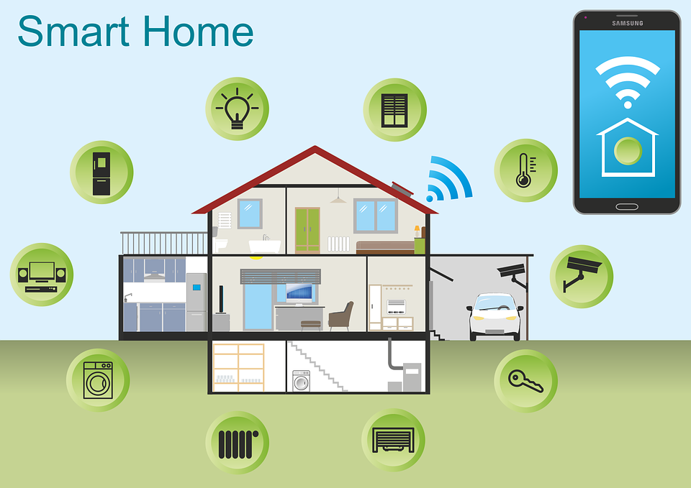
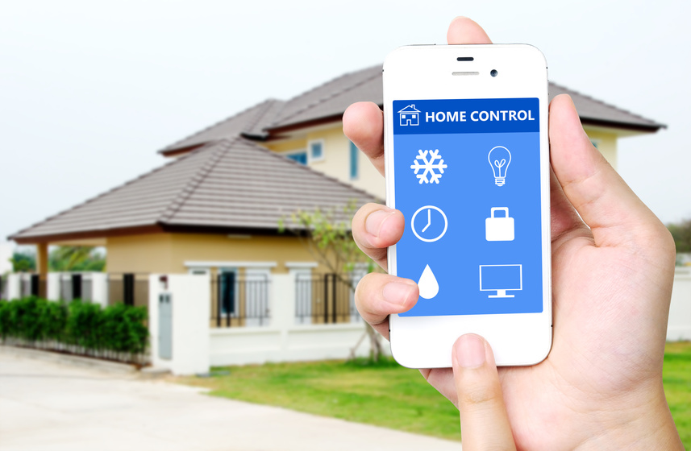
Mechanism of removing as much human interaction as technically possible and replacing them with
programmed electronic systems, essentially the automation of home and housework.
Controlled remotely by a time schedule from any room or from any location in the world by phone.

Slide 3





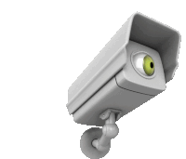
PROBLEMS IDENTIFIED IN EXISTING SYSTEM
Slow data transfer
Connectivity problem
Slow processing
Wired connection
High maintenance cost
Security issues

Slide 4
PROBLEMS IDENTIFIED IN EXISTING SYSTEM
Slow data transfer
Connectivity problem
Slow processing
Wired connection
High maintenance cost
Security issues

Slide 5
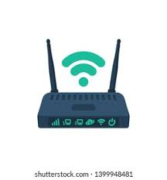
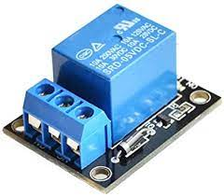
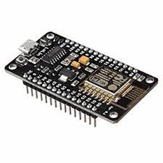
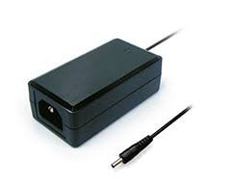
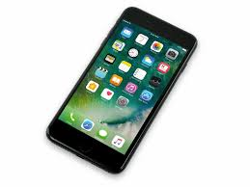
HOME AUTOMATION USING WIFI
Based on the network established between Wi-Fi modules, modem and Smart phone where the smart phone is used to give commands.(No internet connection is required)
The whole system is wireless, won’t be any loss in data at maximum and also there won’t be any problem due to wiring.
All the home appliances are connected to microcontroller through 5V 10A relay, other than no wire connections are required.

Slide 6
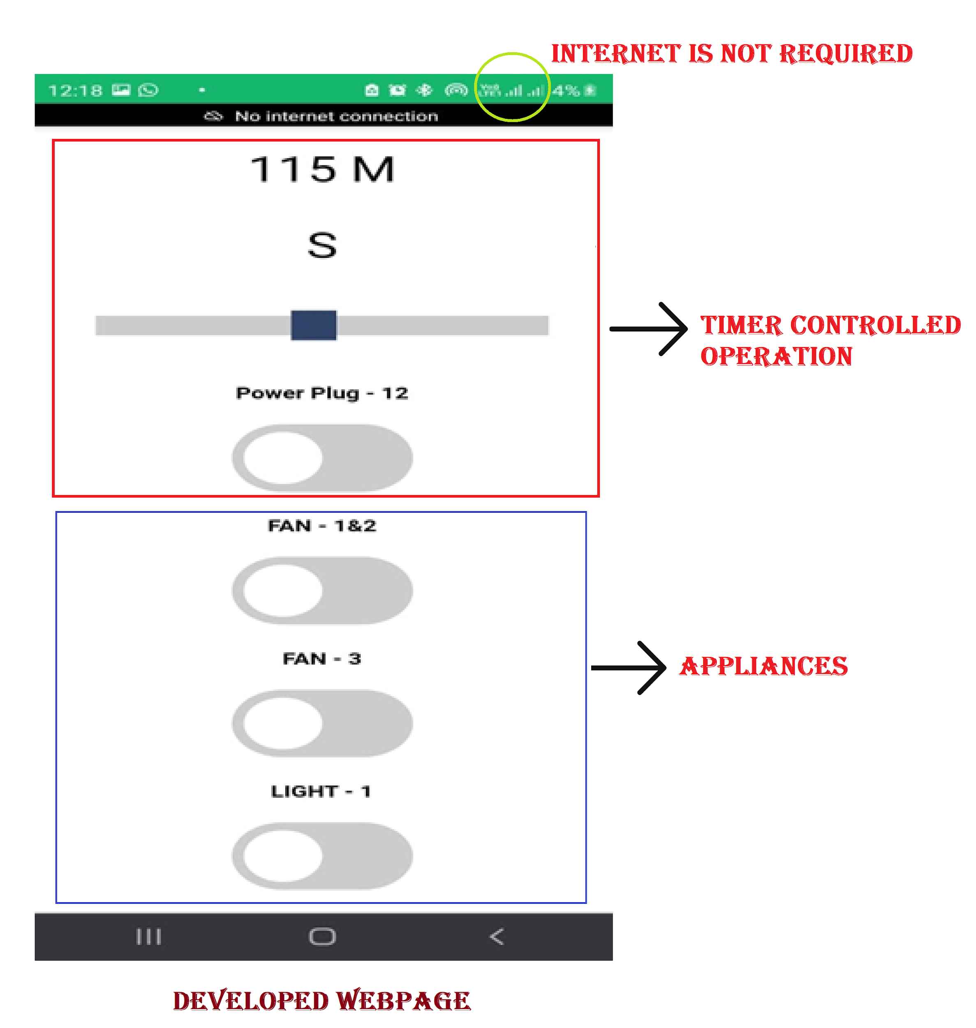
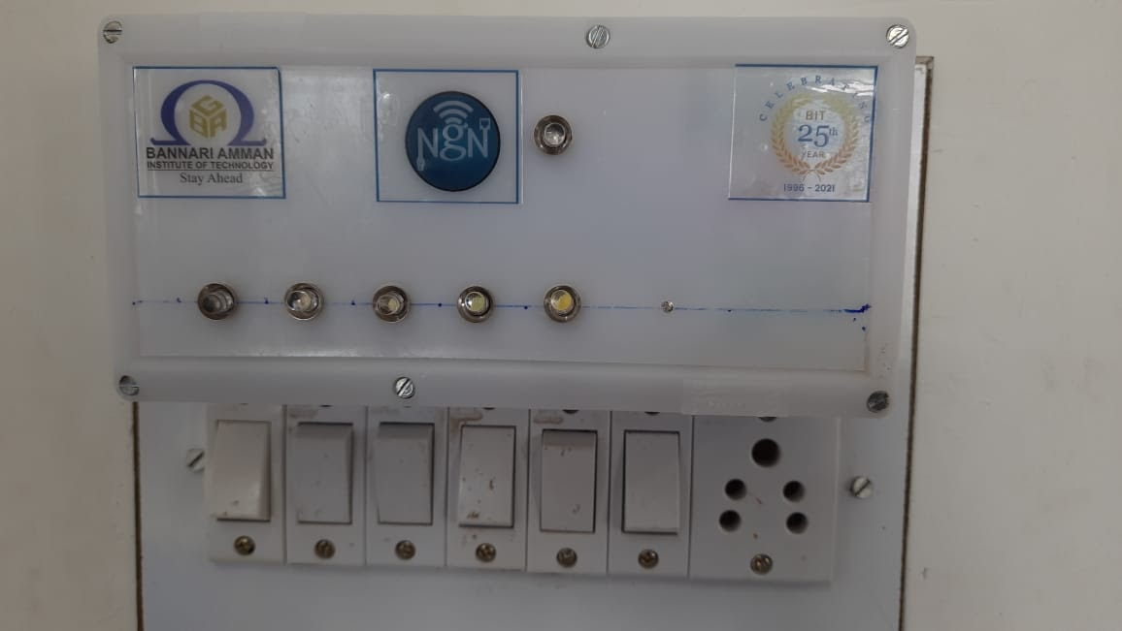
The microcontroller along with Wi-Fi module(NodeMCU) assigned with a static IP address.
The html webpage for the assigned IP address is programmed in the microcontroller.
Whoever in the same network using their smartphone can access the IP address and its corresponding webpage.
The protype can be accommodated with 11 devices. If there is a need can be extended up to n number of devices.

Slide 7
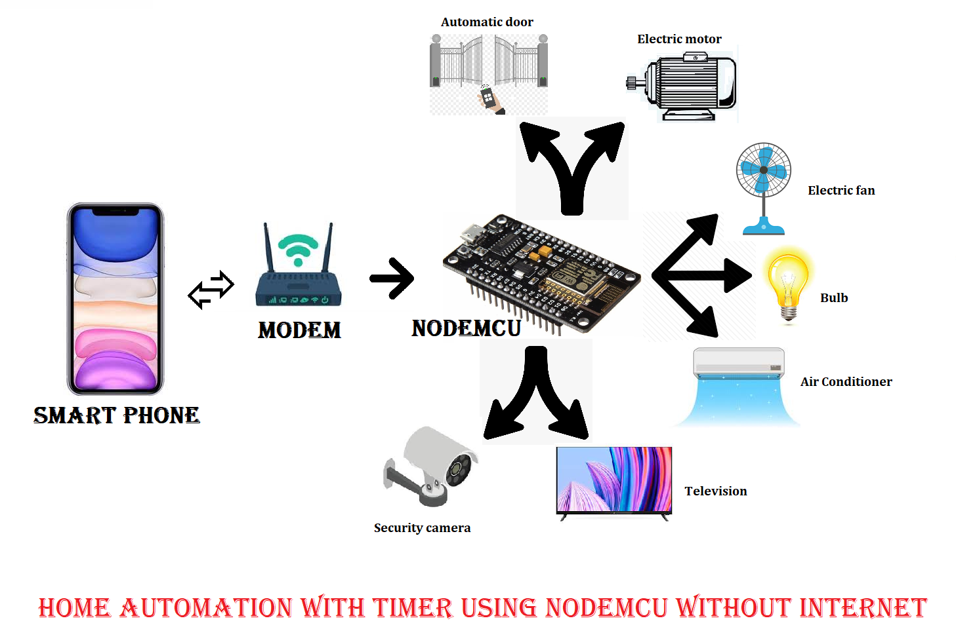
WORKFLOW
https://drive.google.com/file/d/1iQ_15nlz1U2k58QZyg03SwWy6VnBVsG7/view?usp=sharing

Slide 8
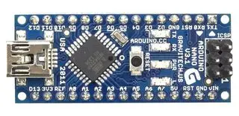
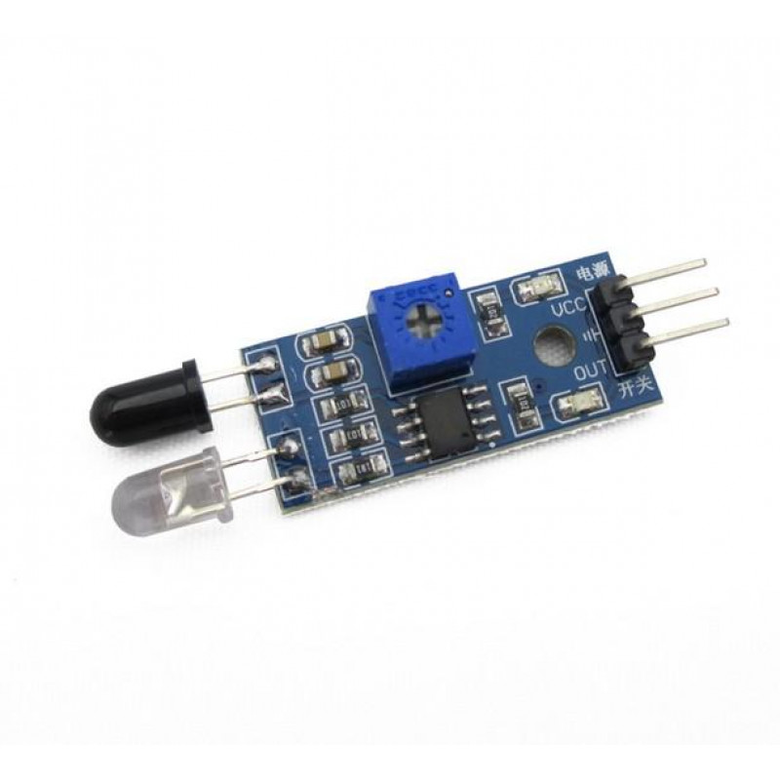
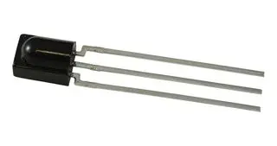
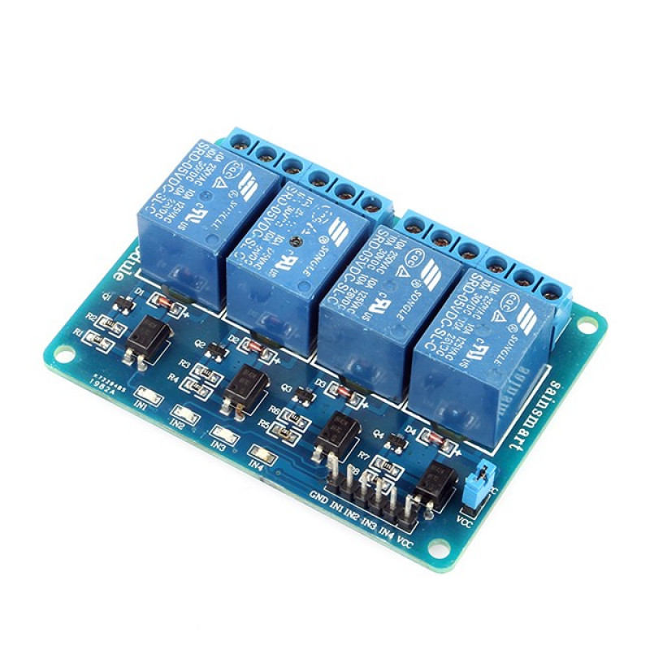
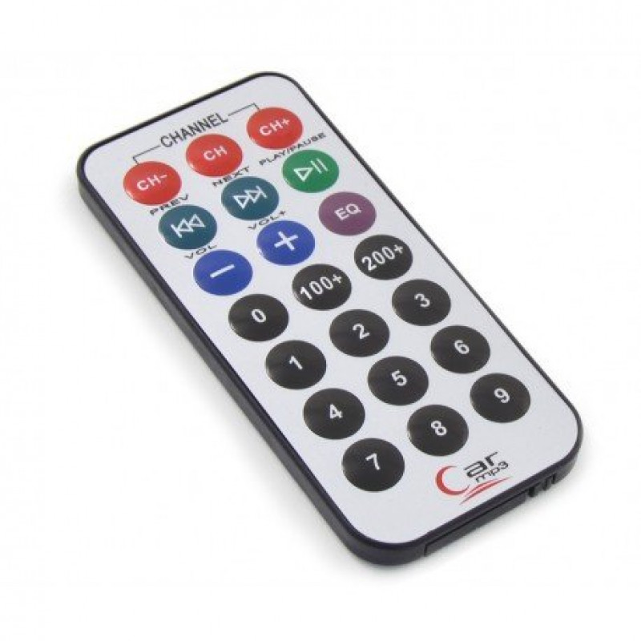
HOME AUTOMATION USING IR
Microcontroller ATMega328P is used for controlling the whole process.
We send some commands to the controlling system by using IR TV/DVD remote for controlling AC home appliances.
After receiving a signal from IR remote, the microcontroller sends related signal to the 8V relays which are responsible for switching ON or OFF of the home appliances through a relay driver
For detecting IR remote signal, we use TSOP1738 IR Receiver.

Slide 9
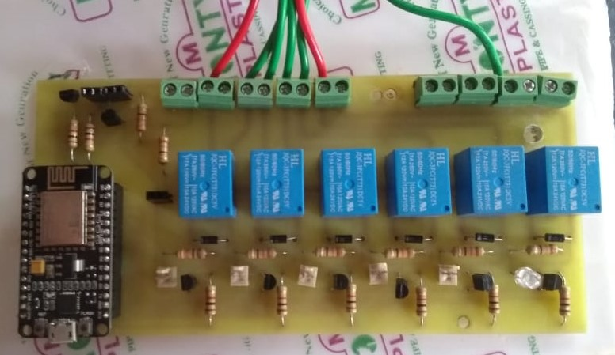
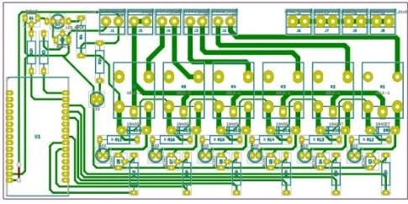
We have used 1,2,3,4,5,6,7, 8 and 9 number buttons of IR TV remote, for controlling fan, light, etc. respectively and it gets turned ON and so all the electrical appliances get turned ON when each number button is pressed
If we want to turn OFF all the electrical appliances, we can press the power button and so all the electrical appliances will get turned OFF.
So, it is easy to control the electrical appliances or AC loads through a single IR TV remote.

Slide 10
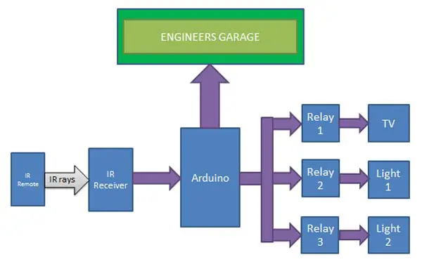
WORKFLOW
https://drive.google.com/file/d/1jrL6QuWLaVP_jOOisUq-GRgA1PrCfiU6/view?usp=sharing

Slide 11
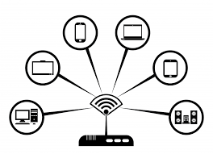





ADVANTAGES
Low cost to design
Controlled through common device
Solves network inoperability
User friendly interface
No internet required
Timer based control

Slide 12
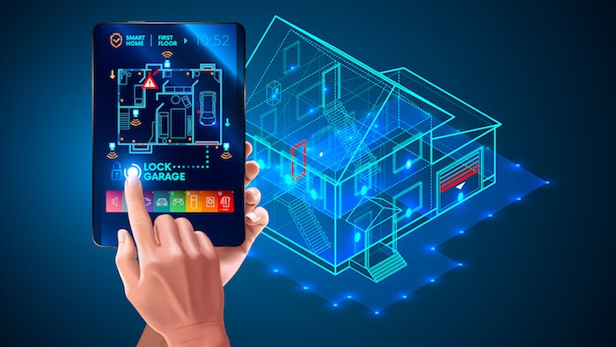
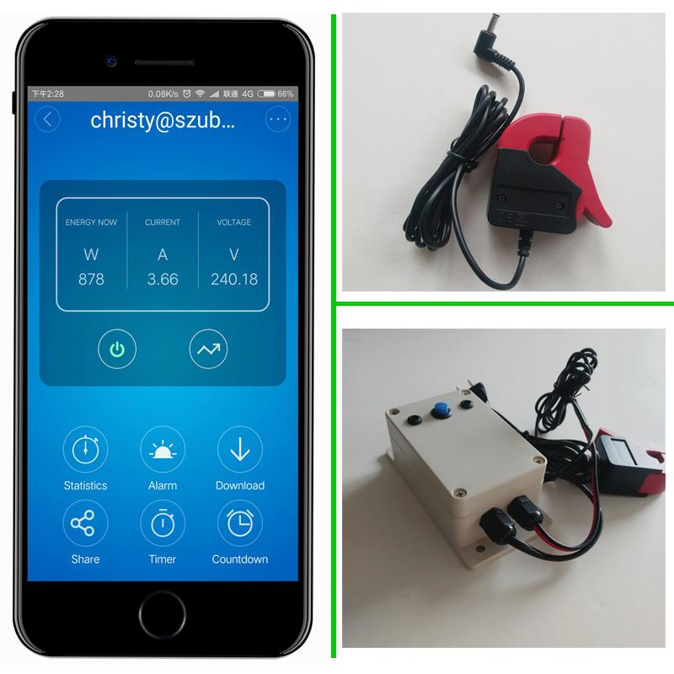
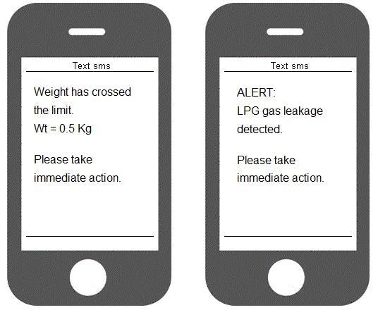
FUTURE EXTENSION
Internet connection is required to control devices from any place. This can be solved by enabling internet setup
CT sensor and Load cell can be added to calculate amount of power consumed and LPG in cylinder
Security can be established by connecting a cctv camera to this setup.

